Slide 1
Tourism Of Nashik
Where Heritage Meets Serenity

Slide 2

We have Completed our Internship in Netleap It Traning and Solutions

Slide 3
Introduction
Welcome to "Tourism of Nashik," your gateway to exploring the vibrant culture and rich history of Nashik. Our website offers comprehensive information about the city's top attractions, from ancient temples to scenic vineyards. Discover curated tours designed to showcase the best of Nashik's heritage and natural beauty.

Slide 4
01
About us

Slide 5

About us
Team and Background: Tourism of Nashik was founded in 2024 by a passionate team of individuals dedicated to showcasing Nashik’s cultural heritage and natural beauty.
Mission: Our mission is to provide visitors with an immersive experience of Nashik through curated tours and comprehensive travel guides while supporting local tourism businesses.
Objectives: We aim to boost tourism in Nashik, provide valuable career opportunities in the tourism sector, and contribute to the city's economic growth.

Slide 6
Key Features of the Website
Comprehensive Travel Guides: Detailed information on Nashik’s attractions, accommodations, dining, and local culture.
Curated Tours: Tailored itineraries designed to showcase the best of Nashik, including historical sites, vineyards, and cultural experiences.
Job Portal: A dedicated platform connecting job seekers with employment opportunities in tourism-related sectors.
User-Friendly Interface: Easy navigation, responsive design, and interactive features to enhance user experience.

Slide 7
Tourist Attractions in Nashik
Trimbakeshwar Temple: One of the twelve Jyotirlingas of Lord Shiva, known for its spiritual significance and architectural beauty.
Sula Vineyards: India’s leading winery offering tours, tastings, and scenic views of vineyards.
Pandavleni Caves: Ancient rock-cut caves dating back to the 1st century BC, showcasing Buddhist architecture and artifacts.

Slide 8
—Emile Zola
“Nothing develops intelligence like travel.”

Slide 9
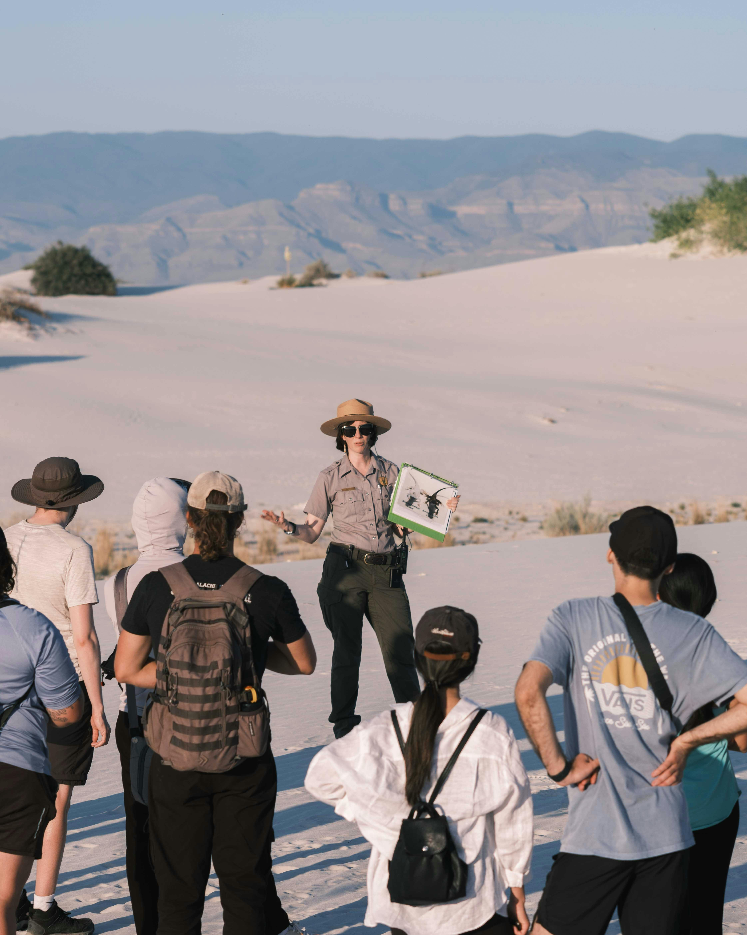
Job Portal
Purpose: Connects job seekers with employment opportunities in the tourism industry, including positions in hospitality, tour guiding, event management, and more.
Benefits for Job Seekers: Offers career growth opportunities, networking with industry professionals, and access to diverse job listings in Nashik’s thriving tourism sector.

Slide 10
User Experience
Interface: Our website features an intuitive interface designed for easy navigation and seamless browsing across devices.
Feedback: Positive feedback from users highlights the website’s effectiveness in providing valuable information and services to visitors and job seekers alike.

Slide 11
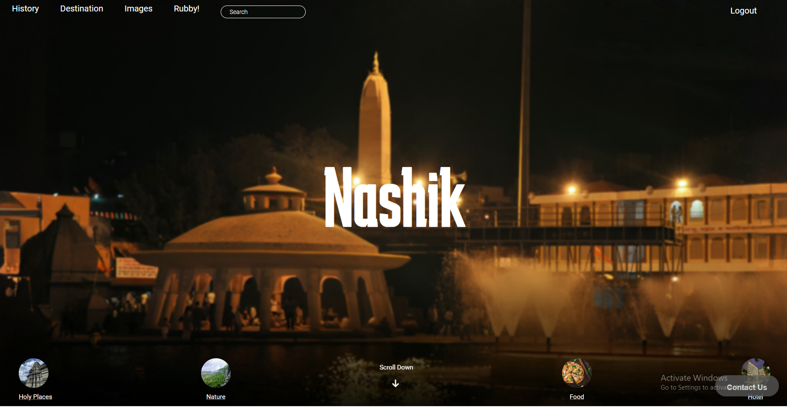
Website

Slide 12

Website

Slide 13
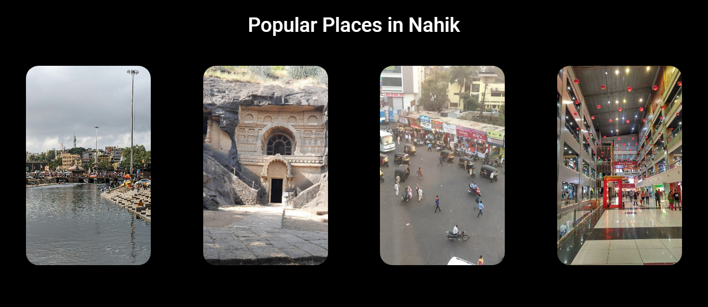
Website

Slide 14
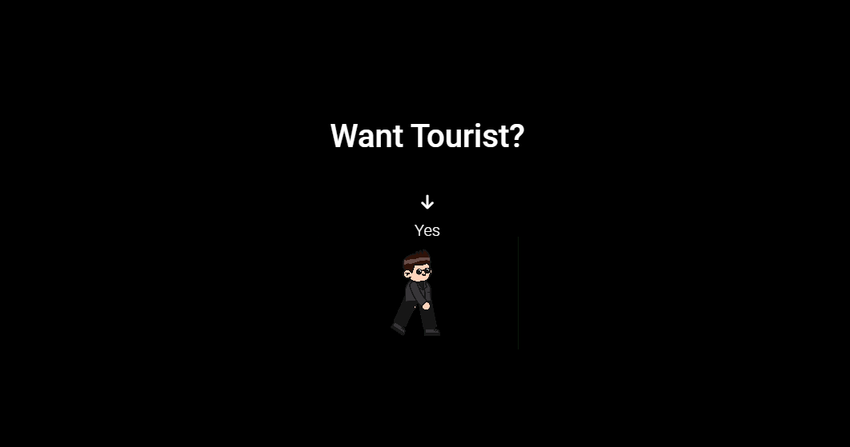
Website

Slide 15
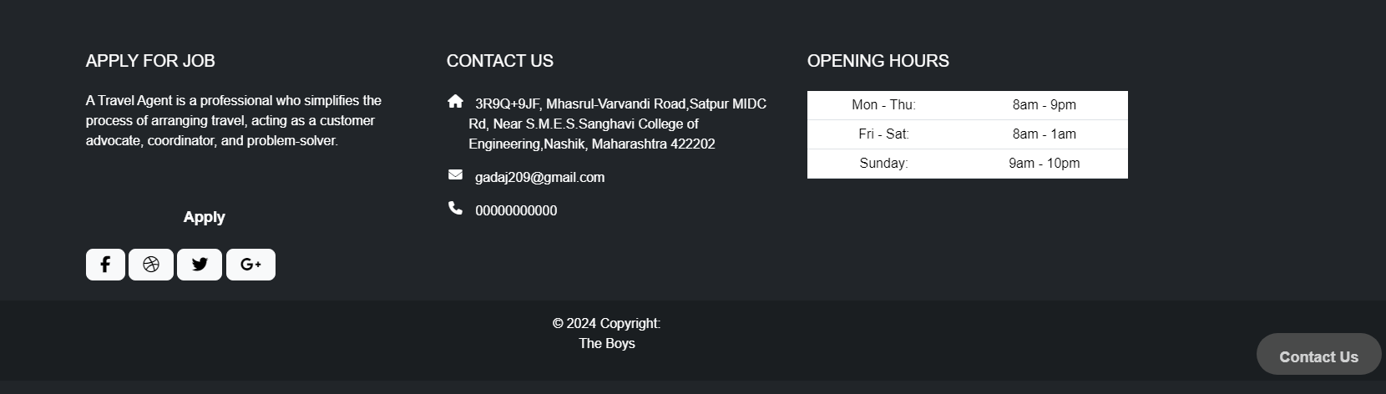
Website

Slide 16

Future Plans
Expansion
Continuously expand our content and services to cover more attractions, enhance user experience, and reach a broader audience.
Community Engagement
Collaborate with local stakeholders to promote sustainable tourism practices and community involvement.

Slide 17

Contact Information
Website URL: www.tourismofnashik.com
Email Address: Contact us at gadaj209@gmail.com for inquiries, partnerships, or support.
Social Media: Follow us on TourismofNashik for updates, travel tips, and more.

Slide 18
Conclusion
Summary: Recap the key highlights of "Tourism of Nashik," including our mission, key features, and achievements.
Call to Action: Encourage the audience to visit our website, explore Nashik’s attractions, and consider career opportunities in the local tourism industry.
Thank You: Express gratitude to the audience for their time and attention.

Slide 19



Our team
Sahil Wagh
Siddhesh More
Suyash Patil
Front-End Developer
Full Stack Web Developer
Front-End Developer

Slide 20
Thanks!
Do you have any questions?
gadaj209@gmail.com
+91 8010577385
www.tourismofnashik.com

